Slide 1
H
HEXA
Cyber-Smart Gaming for Education
Coventry University · 503IT · Team Hexa · 6 Members
BOARD PRESENTATION · JUNE 2026 · 15 MINUTES

Slide 2
Agenda — What We'll Cover Today
01 The Challenge
Why cyber education matters now
02 Our Solution
Introducing Hexa — how it works
03 How We Built It
Tech stack & justification
04 Collaboration
Teamwork, tools & problem-solving
05 User Testing
Feedback, iteration & results
06 The Team
Individual contributions
07 Next Steps
Roadmap & questions
15 MINUTES · TEAM HEXA · COVENTRY UNIVERSITY · 503IT

Slide 3
THE CHALLENGE
Digital Danger Is Rising.
Awareness Isn't.
1 in 3
Low
Years
young users face phishing
or scam attempts online
recall rate from traditional
leaflets & lectures
of exposure before most
receive cyber education
PRESENTER 1 · MEMBER 1

Slide 4
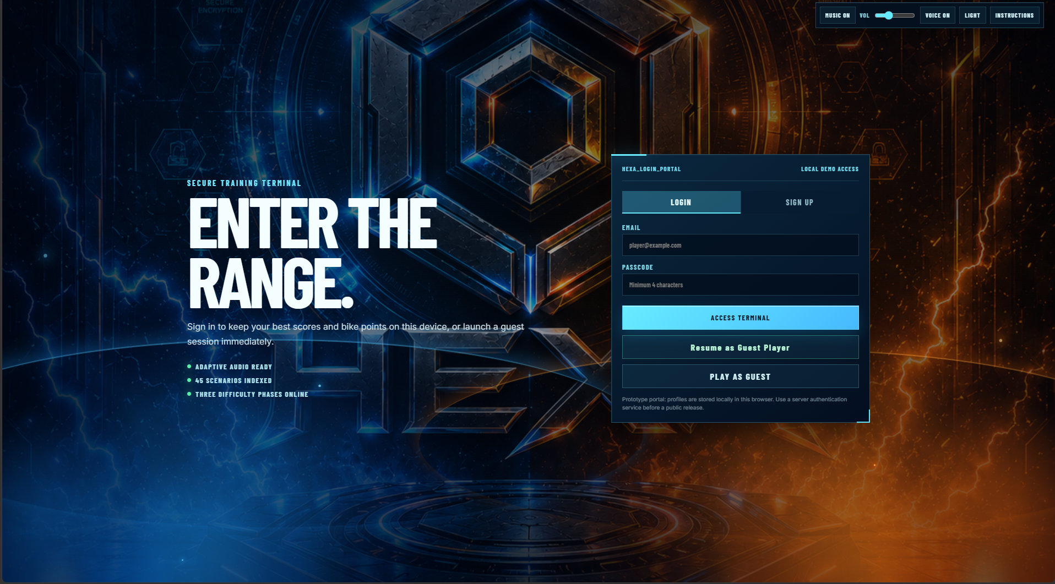
OUR SOLUTION
Introducing
Hexa.
A story-driven cyber-security quiz game where players learn by living real online scenarios.
45 Scenarios
3 Age Groups
Instant Feedback
Runs in Any Browser
PRESENTER 2 · MEMBER 2

Slide 5
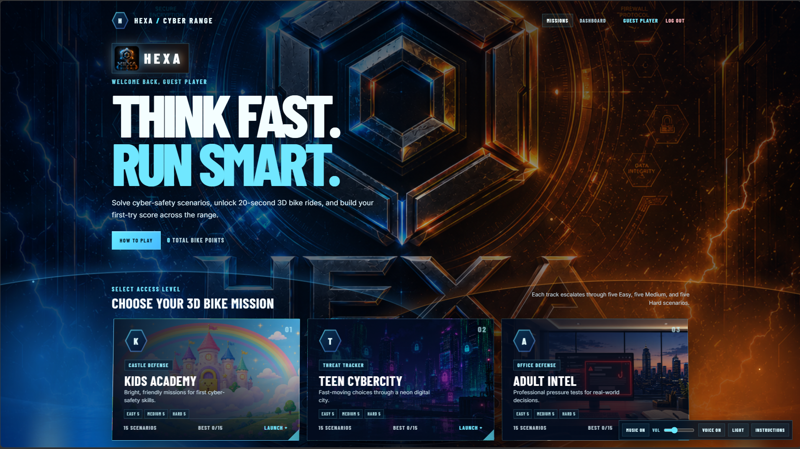
PRESENTER 2 · MEMBER 2

Slide 6
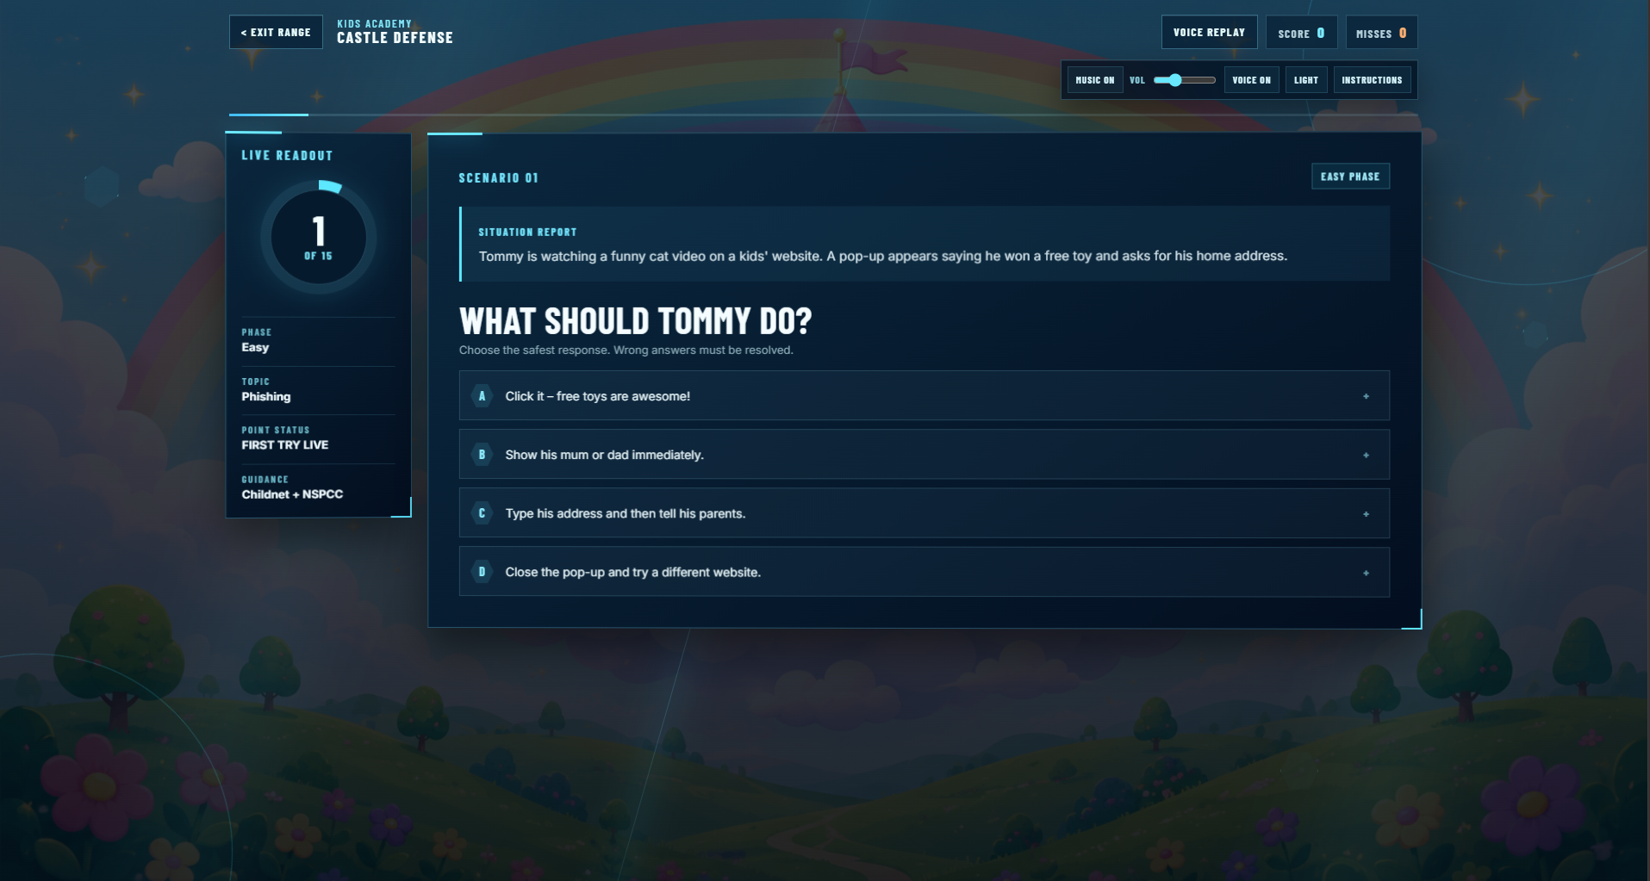
HOW IT WORKS
Learn by Deciding.
1
Enter a Scenario
A suspicious email,
a risky login, a social
media moment.
2
Make a Choice
Pick from realistic
multiple-choice options.
3
Instant Feedback
See the consequence +
a plain-English explanation.
4
Build the Habit
Replay to reinforce
safe behaviour.
PRESENTER 3 · MEMBER 3

Slide 7
DESIGNED FOR EVERYONE
One Game.
Three Audiences.
🏰
🏙️
🏢
CHILDREN
TEENS
ADULTS
Safe internet use
Social media safety
Workplace security
Personal information
Cyberbullying
Financial scams
Spotting online dangers
Phishing & digital privacy
Password & data protection
PRESENTER 3 · MEMBER 3

Slide 8
HOW WE BUILT IT
Built in the Open.
React
CSS
JS
Python
Structure & scenarios
Responsive, age-themed UI
Quiz logic, scoring, feedback
Supporting tooling & data
App.jsx ×
style.css ×
package.json ×
1
import React, { useState } from 'react';
2
import { scenarios } from './data/scenarios';
3
4
export default function HexaQuiz() {
5
const [score, setScore] = useState(0);
6
const [current, setCurrent] = useState(0);
7
// Handle player choice & feedback logic
8
const handleAnswer = (choice) => {
9
if (choice.correct) setScore(s => s + 1);
PRESENTER 4 · MEMBER 4

Slide 9
COLLABORATION
Built Together,
In the Open.
⑂
Git & GitHub
📋
Meeting Minutes
79 commits
Every sprint
One shared repo, branch-based workflow, pull request reviews.
Documented agendas, decisions, and action plans on file.
📖
Members Guide
✅
Task Tracking
6 members aligned
Clear ownership
Onboarding document keeping the whole team in sync.
Defined deadlines and responsible members for every item.
PRESENTER 4 · MEMBER 4

Slide 10
HOW WE BUILT IT
Why We Chose
These Tools.
React
Why not plain HTML/JS?
Component reuse across 3 age groups saved significant build time. State management made quiz logic clean and reliable.
Browser-Based
Why not an app?
No installation required — critical for school environments. Works on any device, any OS, without admin permissions.
Quiz Format
Why not a video?
Active decision-making improves retention vs passive watching. Players live the scenario, making consequences feel real.
PRESENTER 4 · MEMBER 4

Slide 11
COLLABORATION
When Things Got Hard,
We Decided Together.
Tech Stack Decision
Challenge: React vs plain HTML — team was split.
Decision: Voted in sprint meeting. React chosen for component reuse across all 3 age themes.
Scope Management
Challenge: Too many features, tight deadline.
Decision: MoSCoW prioritised as a team. Core quiz delivered first, extras moved to roadmap.
Communication Tools
Day-to-day: WhatsApp group for quick updates.
Formal: Weekly sprint meetings documented in minutes. GitHub for all code decisions.
Delivering the Brief
Brief asked for: An interactive tool to teach cyber safety to multiple age groups.
We delivered: Hexa — 45 real-world scenarios, 3 age groups, browser-based, tested with 18 users.
PRESENTER 4 · MEMBER 4

Slide 12
USER TESTING
We Listened.
Then We Improved.
Early prototypes trialled with real players across all three age groups.
18
92%
4.3★
3×
players in
test sessions
completed a full
scenario unaided
rated the game
fun and clear
rounds of
feedback & iteration
PRESENTER 5 · MEMBER 5

Slide 13
ACCESSIBILITY & INCLUSION
Designed for
Everyone.
What Users Changed
Simpler Wording
◑
High-Contrast Colours
Re-wrote children's questions
in plainer language.
Text and buttons meet readability guidance against the dark theme.
⌨
Keyboard Friendly
Clearer Feedback
All quiz options reachable and selectable without a mouse.
Added 'why' explanation
after every answer.
✦
Plain, Age-Tuned Language
Wording matched to each audience — no jargon for younger players.
Bigger Tap Targets
Enlarged buttons for easier
use on touch screens.
🌐
Runs Anywhere
Browser-based and lightweight — no powerful device required.
PRESENTER 5 · MEMBER 5

Slide 14
THE TEAM
Six Members.
One Solution.
AB
Aaditya Bhandari
SJS
Sandesh Jung Shah
AB
Abdullah Badhurdeen
Team Lead & Frontend — Built quiz engine & age-themed UI
UI / UX Design — Wireframes, visual design & accessibility
Backend & Logic — Scoring system & scenario data structure
M1
Sijan Bhandhari
M2
Johns Jimee
M3
Nabin Sunar
Content & Scenarios — Wrote 45 quiz scenarios across 3 age groups
Testing & QA — Led 18-player user test sessions & iteration
Docs & Comms — Meeting minutes, Members Guide & task tracking
PRESENTER 6 · MEMBER 6

Slide 15
NEXT STEPS
What Comes Next.
NOW
Q3 2026
Q4 2026
2027
Public Release
School Pilots
Dashboard
Expansion
Deploy to Coventry
University network.
Partner with local
primary schools.
Teacher analytics &
progress tracking.
New scenarios,
new age tracks.
PRESENTER 6 · MEMBER 6

Slide 16
⬡
HEXA
Cyber-Smart Gaming for Education
Thank you.
Questions welcome · Team Hexa · Coventry University · 503IT
COVENTRY UNIVERSITY · 503IT · COMMUNICATION & COLLABORATION · JUNE 2026

